Slide 1
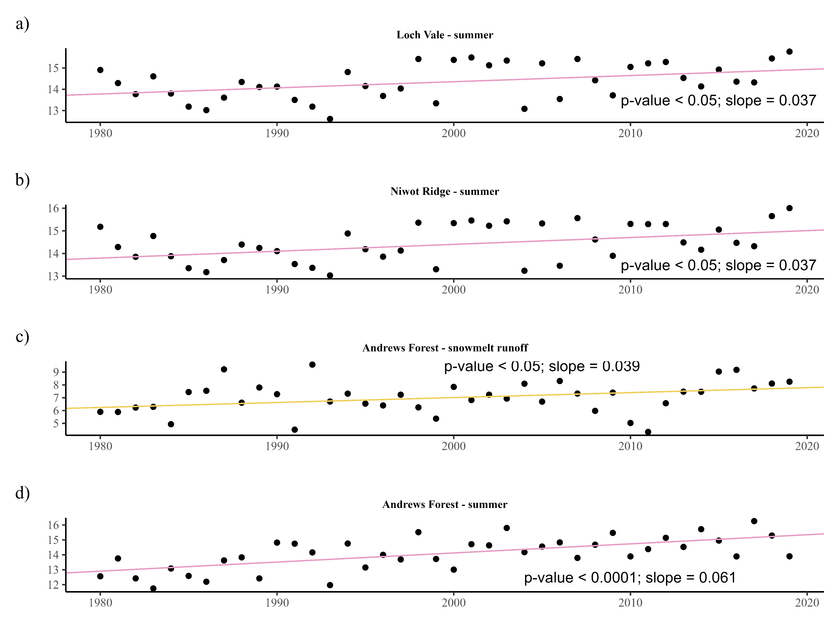
Mean seasonal air temperature (°C)

